Slide 1
Smart Transportation
DREAM Team [Team 19]
Abhilash K, Ravikant, Rajrup,Amogh

Slide 2
The high level idea
With smart transportation via IoT connected transportation assets you can:
Send alerts to drivers and emergency responders:
If speed of vehicle crosses a certain speed limit trigger Camera to capture
snap of the street view in an interval of 2 secs. Send an Alert to subscribed authority using MQTT broker at Azure Cloud.
Smart detector to detect accident and send emergency alert to MQTT broker at Azure Cloud.
Detect Servicing status of the Car using O2 Sensor
Provide visualization for different parameters

Slide 3





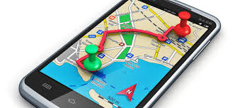
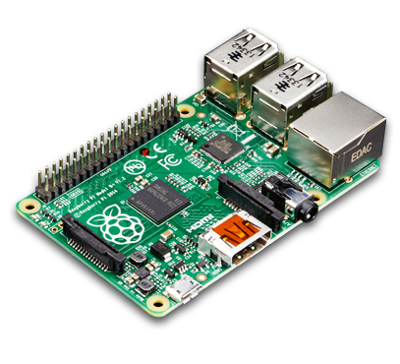
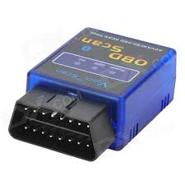
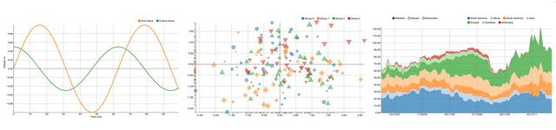
The high level Overview
Map API
Road,speed limit
Street info
Speed limit
GPS coords.
Street info
ALERT
ALERT
Publish (speed)
subscribe(log data)
TOPIC: data/speed, data/throttle, data/gear-level
RPM, Vehicle Speed, Odometer Reading, Throttle position,O2 sensor
Visualization of time-series data
(Matplotlib Plot)

Slide 4
Storm Topology
Spout ( Subscribed to current Speed )
Publish ALERT if
Speed > Speed Limit
Spout ( Subscribed to Speed Limit )

Slide 5
Expected social impact/business value
• Improved Safety
Maintain driver and vehicle safety with remote vehicle diagnostics that make it easier for service centers to
respond to driver drowsiness, vehicle theft, accidents, natural disasters, and requests for towing, repair, gasoline
supply, and tire changes.
• Higher Reliability
Avoid downtime and expensive unplanned repairs with a vehicle performance tracking system that sends notifications of imminent maintenance issues.
• More Conveniences
Enable drivers to access information on weather conditions, scenic spots, gasoline stations, rest stops, hotel
rates, restaurants, parking lots, etc.

Slide 6
List of sensors/devices/software/tool chain used
Sensor
OBD II Scanner
GPS ( from smartphone)
Camera
Software tools
Apollo MQTT
Apache Storm

Slide 7
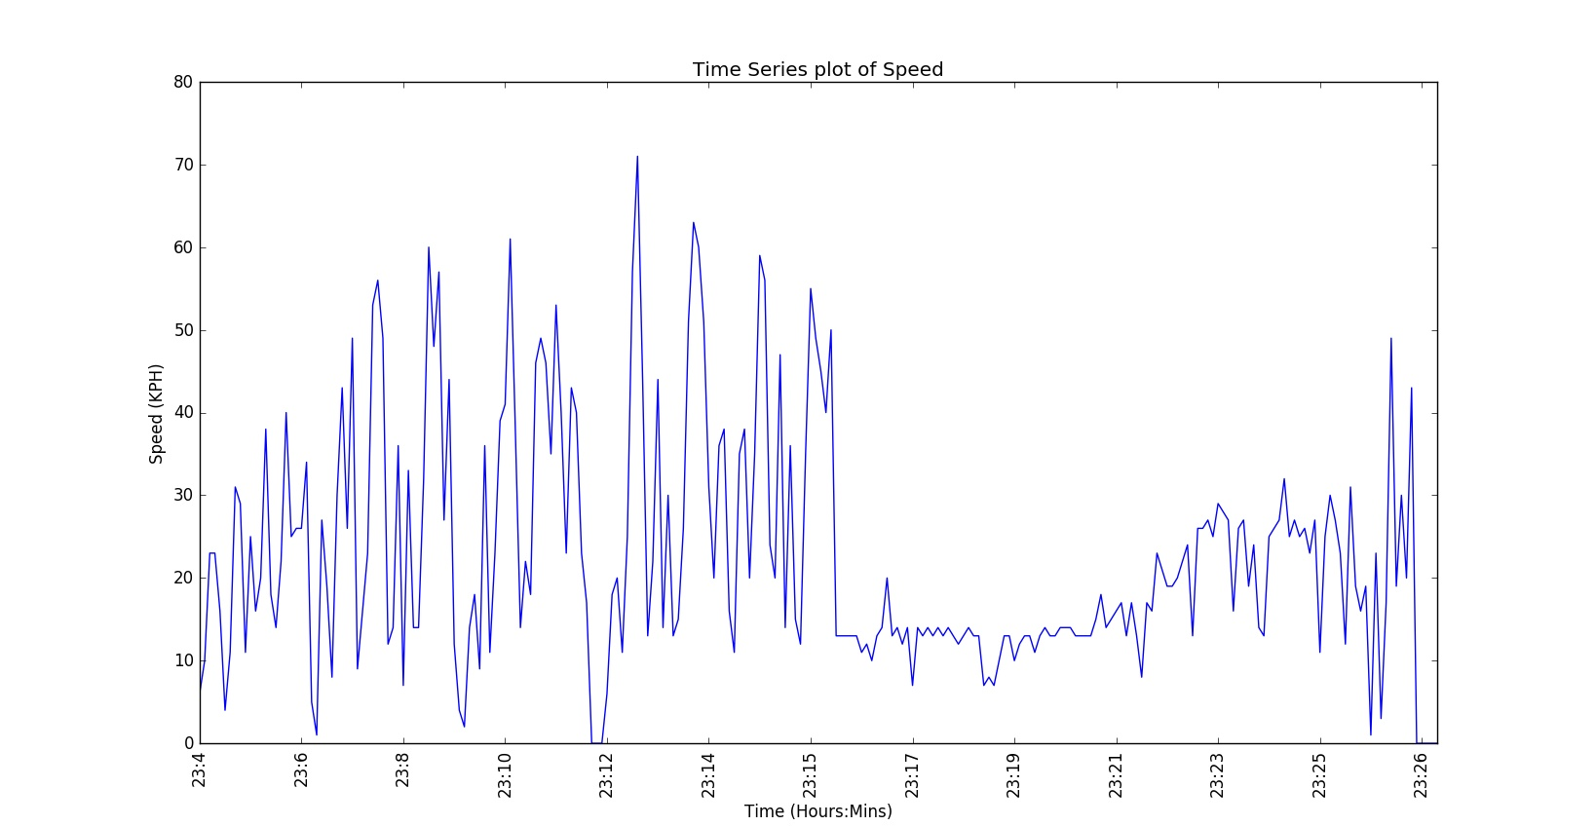
Results/outcomes

Slide 8
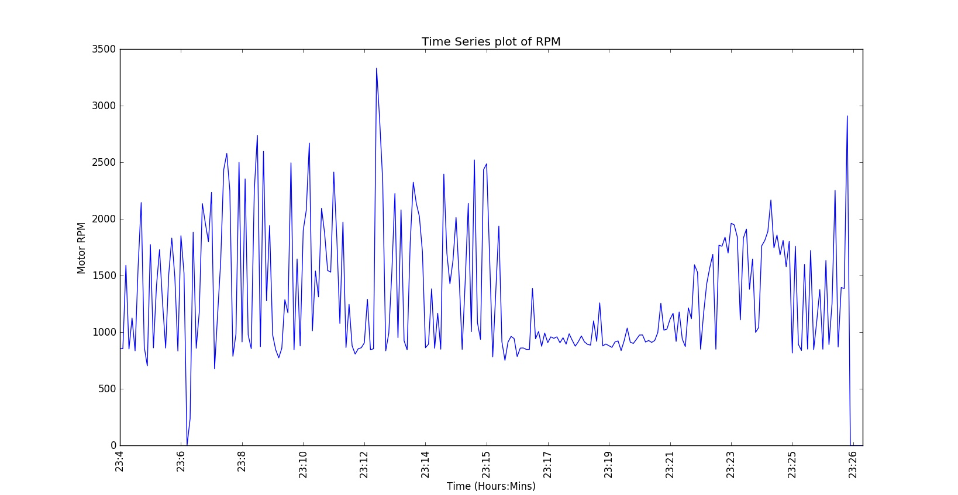
Results/outcomes

Slide 9
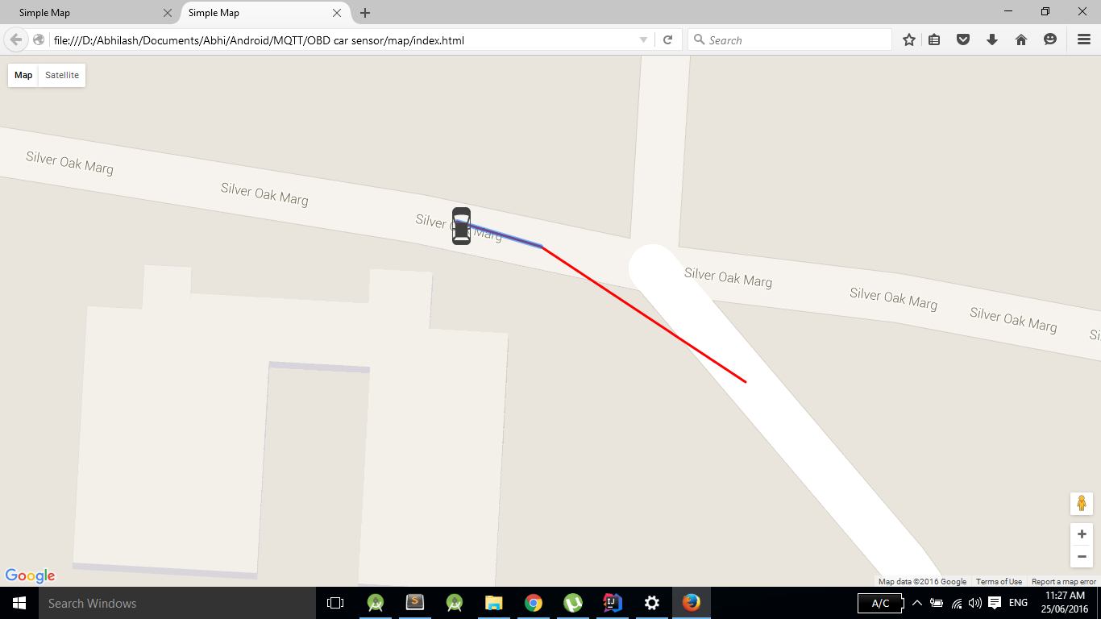
Results/outcomes

Slide 10
Future Work
Generate alerts for
driver drowsiness,
vehicle theft
Accidents using more parameters like air bag deployment
sends notifications of imminent maintenance issues.
More convenience by providing notifications for
weather conditions,
scenic spots
gasoline stations

